Slide 1

Angular Part 8 – Dynamic & Lazy Loading Components Wednesday, January 24, 2024

Slide 2


Agenda
Dynamic Loading Components
Lazy Loading

Slide 3
Dynamic Loading Components
One can use either *ngIf directive or dynamic component loader to dynamically loading components
*ngIf
Dynamic Components
Dynamic Component Loader

Slide 4
Dynamic Loading Components *nfIf
The messaage-box example below load component dynamically using *ngIf
File: authentication.component.html
<div class="container">
<div class="row">
<div class="col-xs-12">
<app-message-box [message]="error" *ngIf="error" (close)="onCloseMessageBox()"></app-message-box>
<form (ngSubmit)="onSubmit(authForm)" #authForm="ngForm">
<div class="form-group">
<label for="email">email</label>
<input
ngModel
required
email
name="email"
type="text"
id="email"
class="form-control" />
</div>
<div class="form-group">
<label for="password">Password</label>
<input type="password" id="password" class="form-control" />
</div>
<br />
<button class="btn btn-primary" type="submit">Submit</button>
</form>
</div>
</div>
</div>
File: message-box.component.html
<div class="backdrop"></div>
<div class="message-box">
<p>{{message}}</p>
<button (click)="onClose()" class="btn btn-primary">Close</button>
</div>
File: message-box.component.ts
@Component({
selector: 'app-message-box',
standalone: true,
imports: [],
templateUrl: './message-box.component.html',
styleUrl: './message-box.component.css'
})
export class MessageBoxComponent {
@Input() message: string | null = null
@Output() close = new EventEmitter()
onClose (): void {
this.close.emit()
}
}

Slide 5
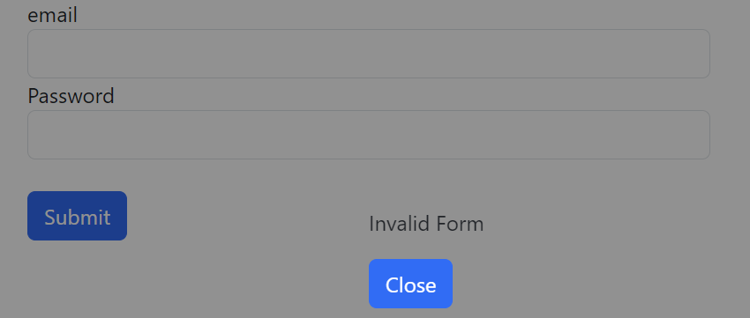
Dynamic Loading Components *nfIf
The example below shows the message box pops up and the closing of the message box by setting this.error = null
import { CommonModule } from '@angular/common'
import { Component } from '@angular/core'
import { FormsModule, type NgForm } from '@angular/forms'
import { MessageBoxComponent } from '../message-box/message-box.component'
@Component({
selector: 'app-authentication',
standalone: true,
imports: [FormsModule, CommonModule, MessageBoxComponent],
templateUrl: './authentication.component.html',
styleUrl: './authentication.component.css'
})
export class AuthenticationComponent {
error: string | null = null
onSubmit (form: NgForm): void {
if (form.valid === false) {
this.error = 'Invalid Form'
return
}
console.log(form)
}
onCloseMessageBox (): void {
this.error = null
}
}

Slide 6
Dynamic Component Loader
Example below shows the showMessage function to load MessageBoxComponent and to use local reference #viewContainerRef
File: authentication.component.ts
@Component({
selector: 'app-authentication',
standalone: true,
imports: [FormsModule, CommonModule, MessageBoxComponent],
templateUrl: './authentication.component.html',
styleUrl: './authentication.component.css'
})
export class AuthenticationComponent {
@ViewChild('viewContainerRef', { read: ViewContainerRef, static: true }) messageBoxContainer!: ViewContainerRef
closeMessageBoxSub!: Subscription
onSubmit (form: NgForm): void {
if (form.valid === false) {
this.showMessage('Dynamic Invalid Form')
return
}
console.log(form)
}
showMessage (message: string): void {
this.messageBoxContainer.clear()
const componentRef = this.messageBoxContainer.createComponent(MessageBoxComponent)
componentRef.instance.message = message
this.closeMessageBoxSub = componentRef.instance.close.subscribe(() => {
this.closeMessageBoxSub.unsubscribe()
this.messageBoxContainer.clear()
})
}
File: authentication.component.html
<div class="container">
<div class="row">
<div class="col-xs-12">
<!--<app-message-box [message]="error" *ngIf="error" (close)="onCloseMessageBox()"></app-message-box>-->
<ng-container #viewContainerRef></ng-container>
<form (ngSubmit)="onSubmit(authForm)" #authForm="ngForm">
<div class="form-group">
<label for="email">email</label>
<input ngModel
required
email
name="email"
type="text"
id="email"
class="form-control" />
</div>
<div class="form-group">
<label for="password">Password</label>
<input type="password" id="password" class="form-control" />
</div>
<br />
<button class="btn btn-primary" type="submit">Submit</button>
</form>
</div>
</div>
</div>

Slide 7
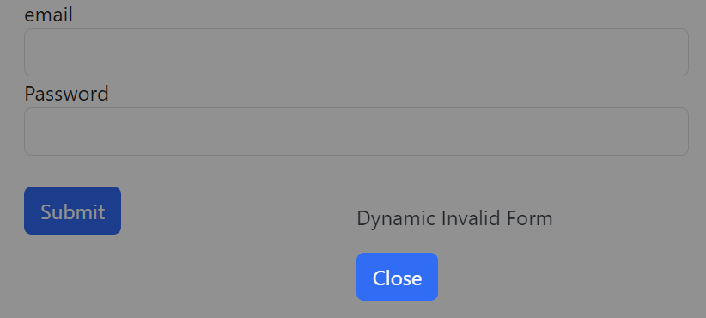
Dynamic Component Loader
import { Component, EventEmitter, Input, Output } from '@angular/core'
@Component({
selector: 'app-message-box',
standalone: true,
imports: [],
templateUrl: './message-box.component.html',
styleUrl: './message-box.component.css'
})
export class MessageBoxComponent {
@Input() message: string | null = null
@Output() close = new EventEmitter()
onClose (): void {
this.close.emit()
}
}
File: message-box.component.html
<div class="backdrop"></div>
<div class="message-box">
<p>{{message}}</p>
<button (click)="onClose()" class="btn btn-primary">Close</button>
</div>

Slide 8
Lazy Loading
Two ways to load the component:
Eager Loading – Load all components at once
Lazy Loading – Load components on demand using import. Note that the Resume component is not declared in the app.route.ts file
File: app.route.ts
import { type Routes } from '@angular/router'
import { AuthenticationComponent } from './authentication/authentication.component'
export const routes: Routes = [
{ path: '', redirectTo: 'authentication', pathMatch: 'full' },
{ path: 'authentication', component: AuthenticationComponent },
{ path: 'resume', loadComponent: async () => (await import('./resume/resume.component')).ResumeComponent }
]

Slide 9

Thank you
Sonny Hoang
sthoang62@gmail.com

